Slide 1

Season Planning
The Bionic Tigers - FTC 10464

Slide 2
What is season planning?

Slide 3
Time Management
Know all your moving parts
Decide priorities
Create calendar
Meeting agendas

Slide 4
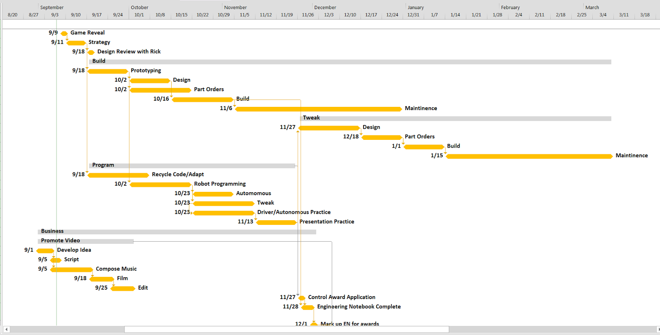

Slide 5
Outreach
Always plan ahead
Put in work equivalent to benefit
Decide on the quantity of outreach
Be prepared
Requirements
Know the plan
Use the summer and days off to your advantage
great time to do outreach (not as busy)

Slide 6
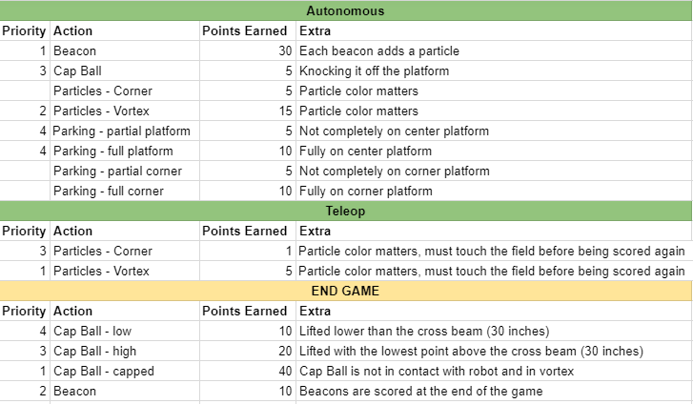
Strategy and Brainstorming
Major key to success
Set aside appropriate time for strategy
Plan before you start building/programming
measure twice, cut once
Strategy controls design
Reevaluate after competition

Slide 7
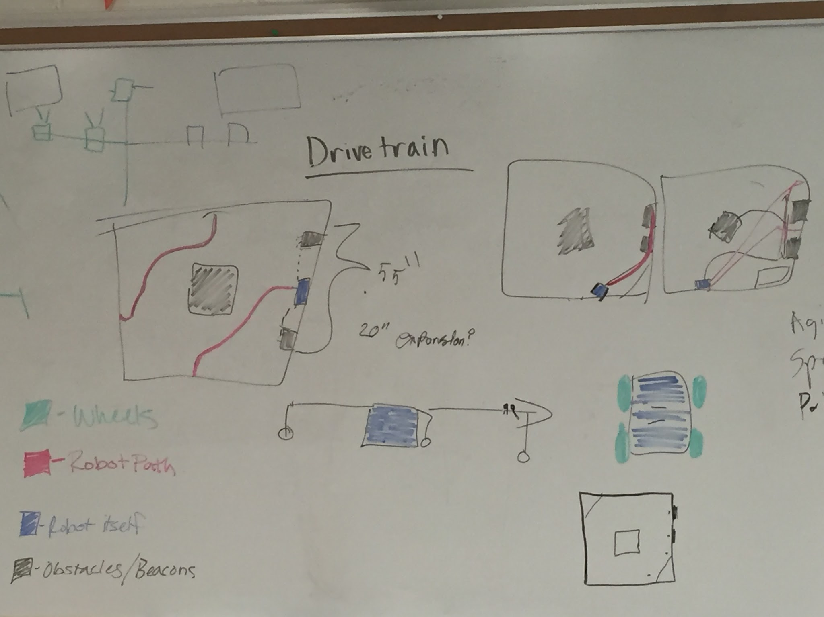
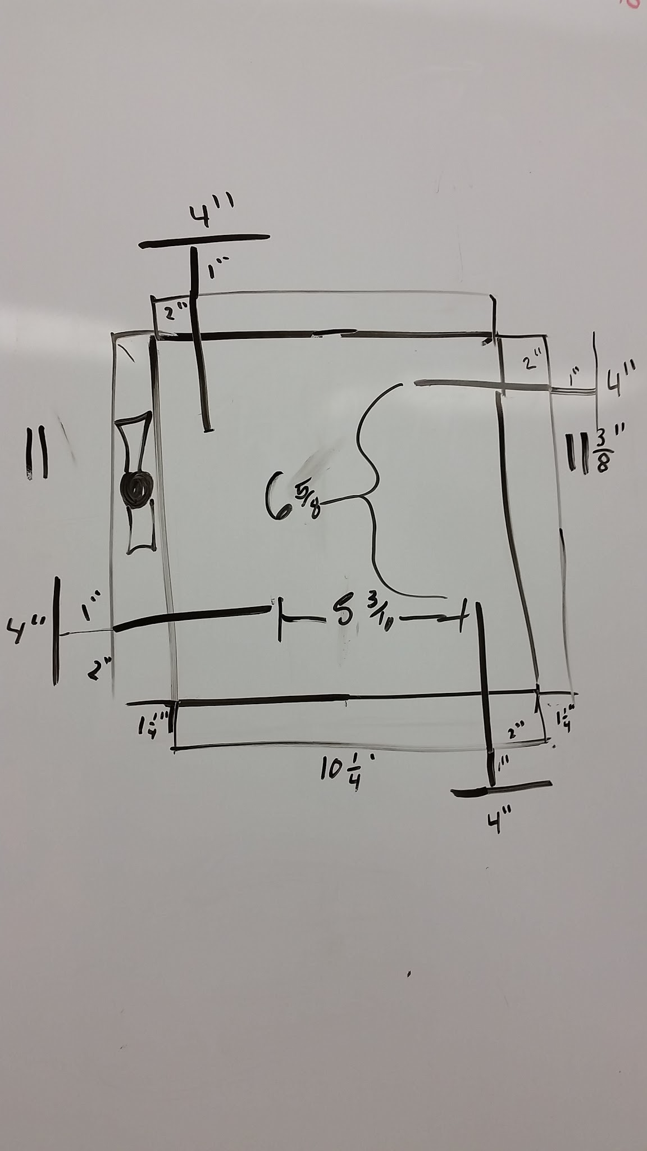
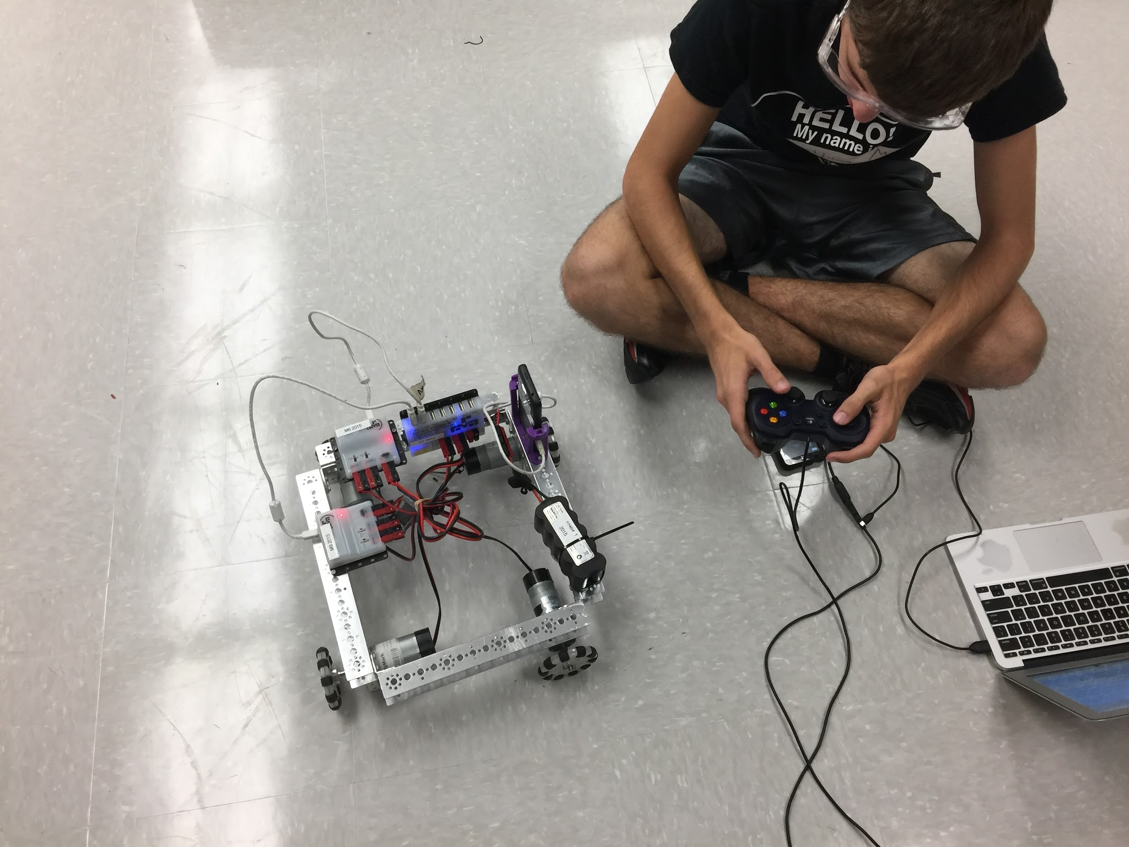
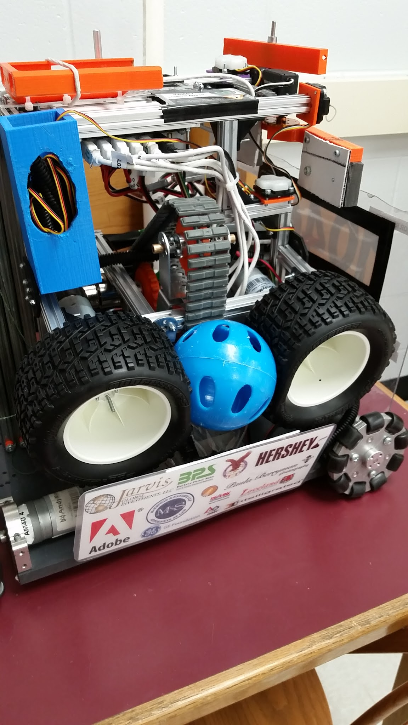
Build
Division of work
Initial Design
Follow strategy requirements
Brainstorming
Prototype
Try different mechanisms
Evaluate against strategy
Finalize Design
Decide on mechanisms
Build it
Make sure you are communicating with your programmers to see where they are, what they need built, and when programmers can have the robot to test. Create a nice balance and leave time.

Slide 8
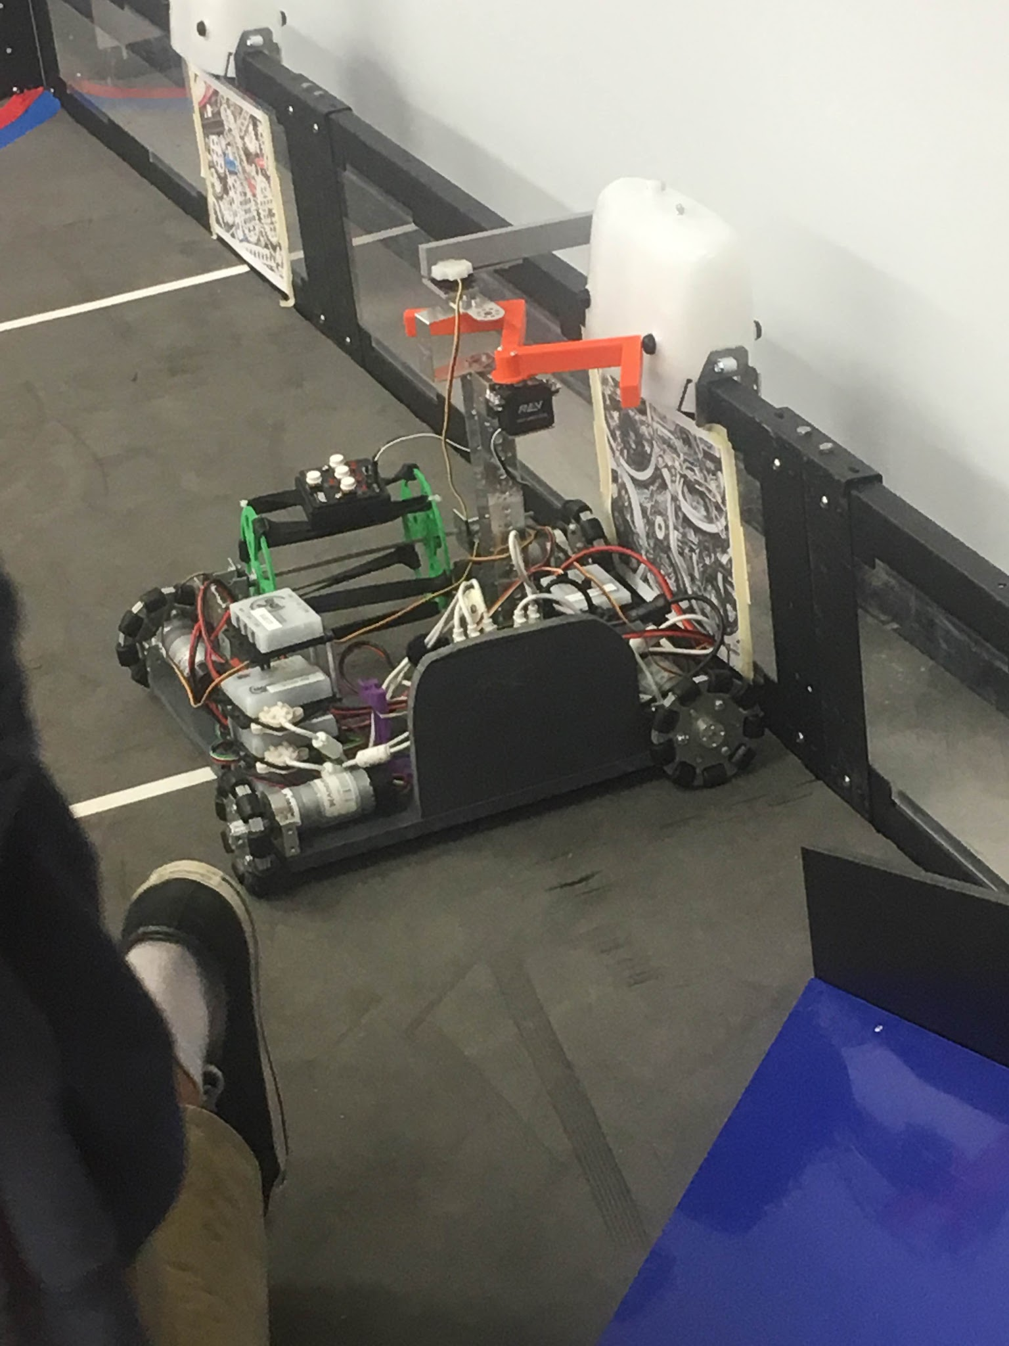
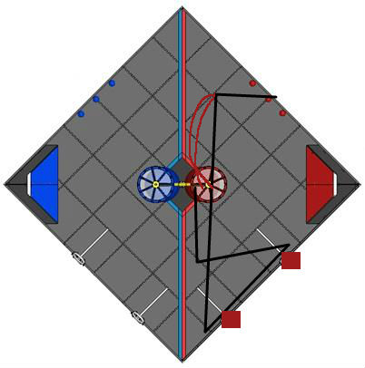
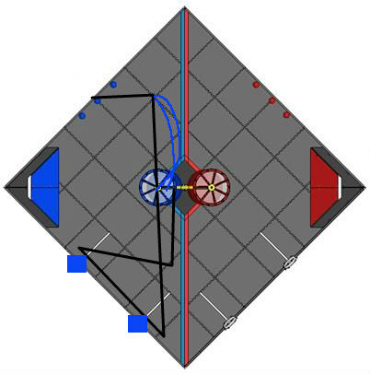
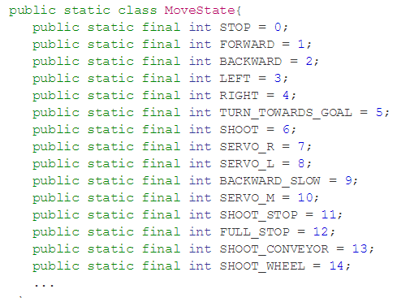
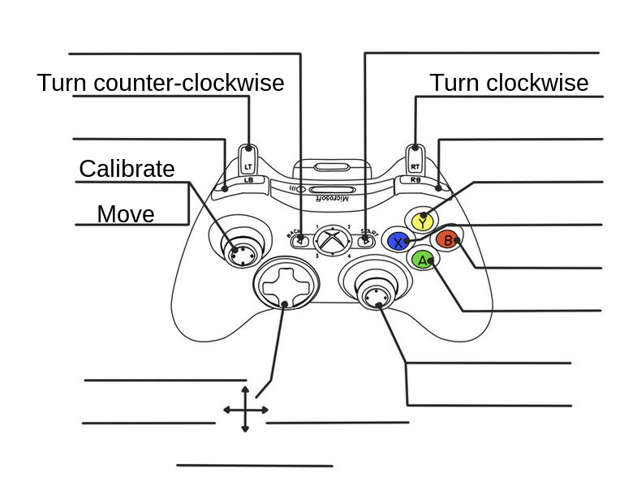
Programming
Autonomous
Lay out objectives
Plan path
Maximize time
TEST
Takes a lot of time, so plan ahead
TeleOp
Optimize to drivers
Plan for complexity level
Make sure you are communicating with your builders to see where they are, what they need programmed, and when programmers can have the robot to test.

Slide 9
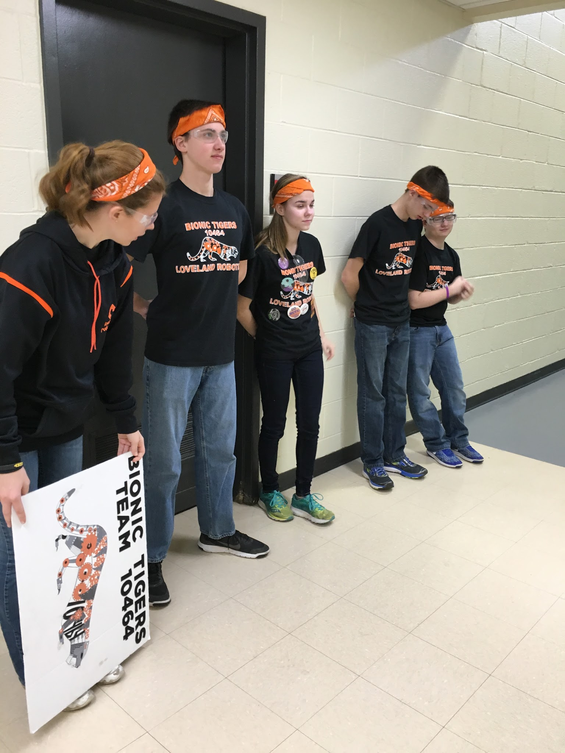
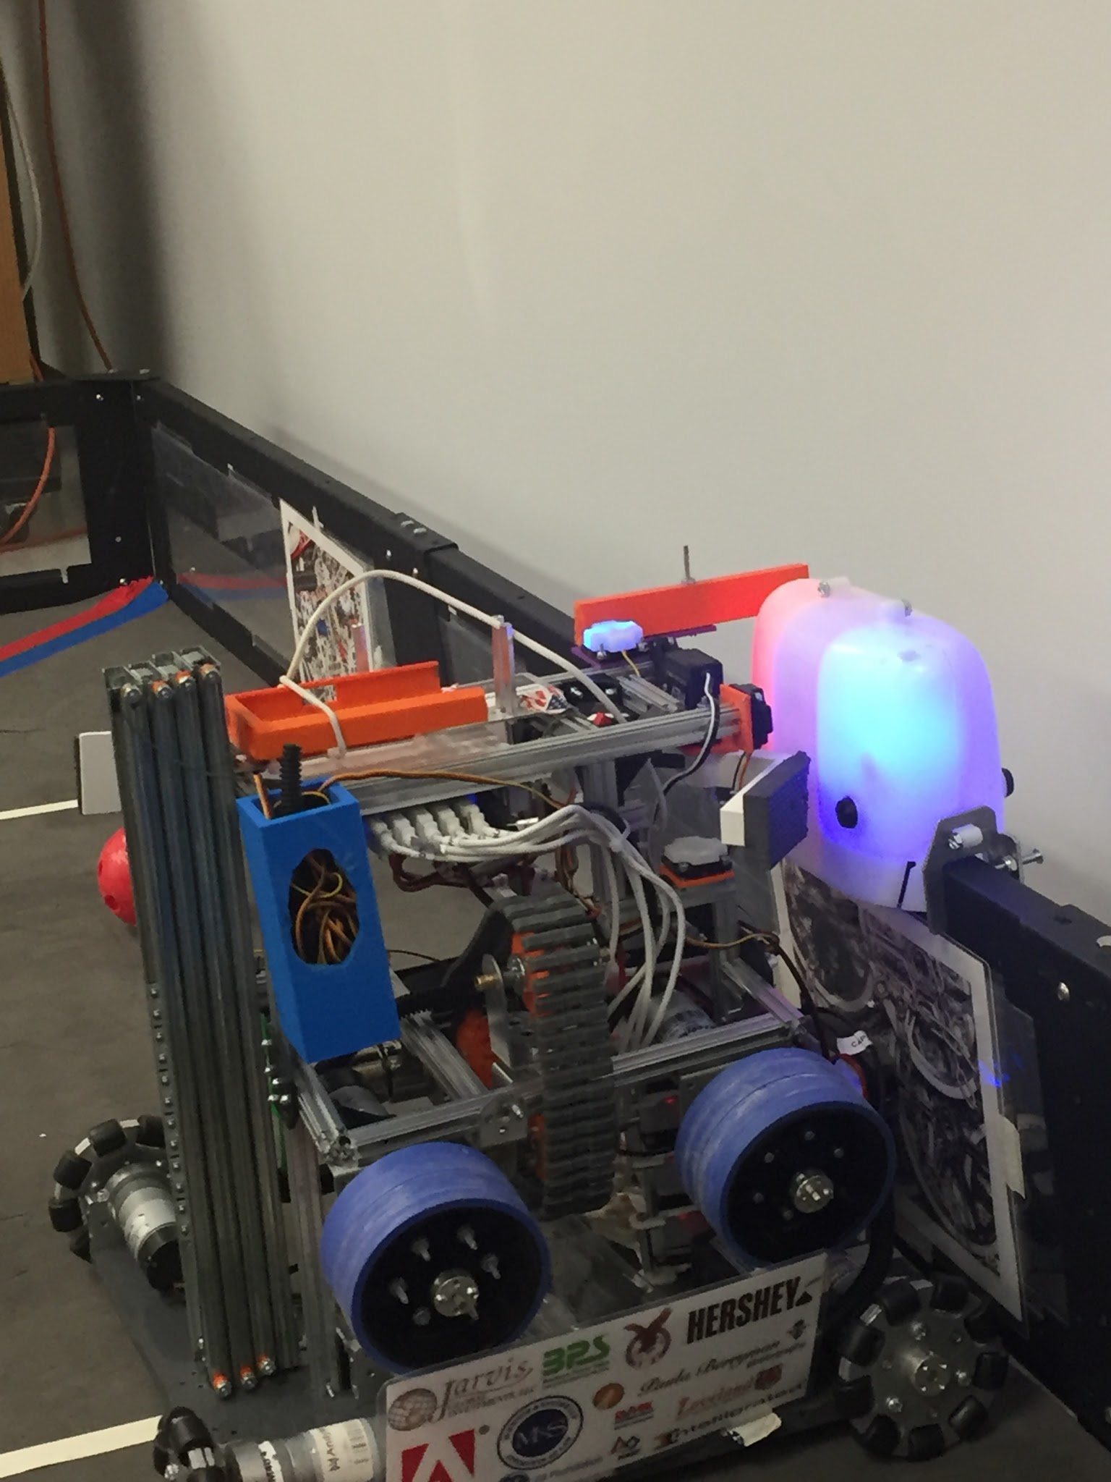
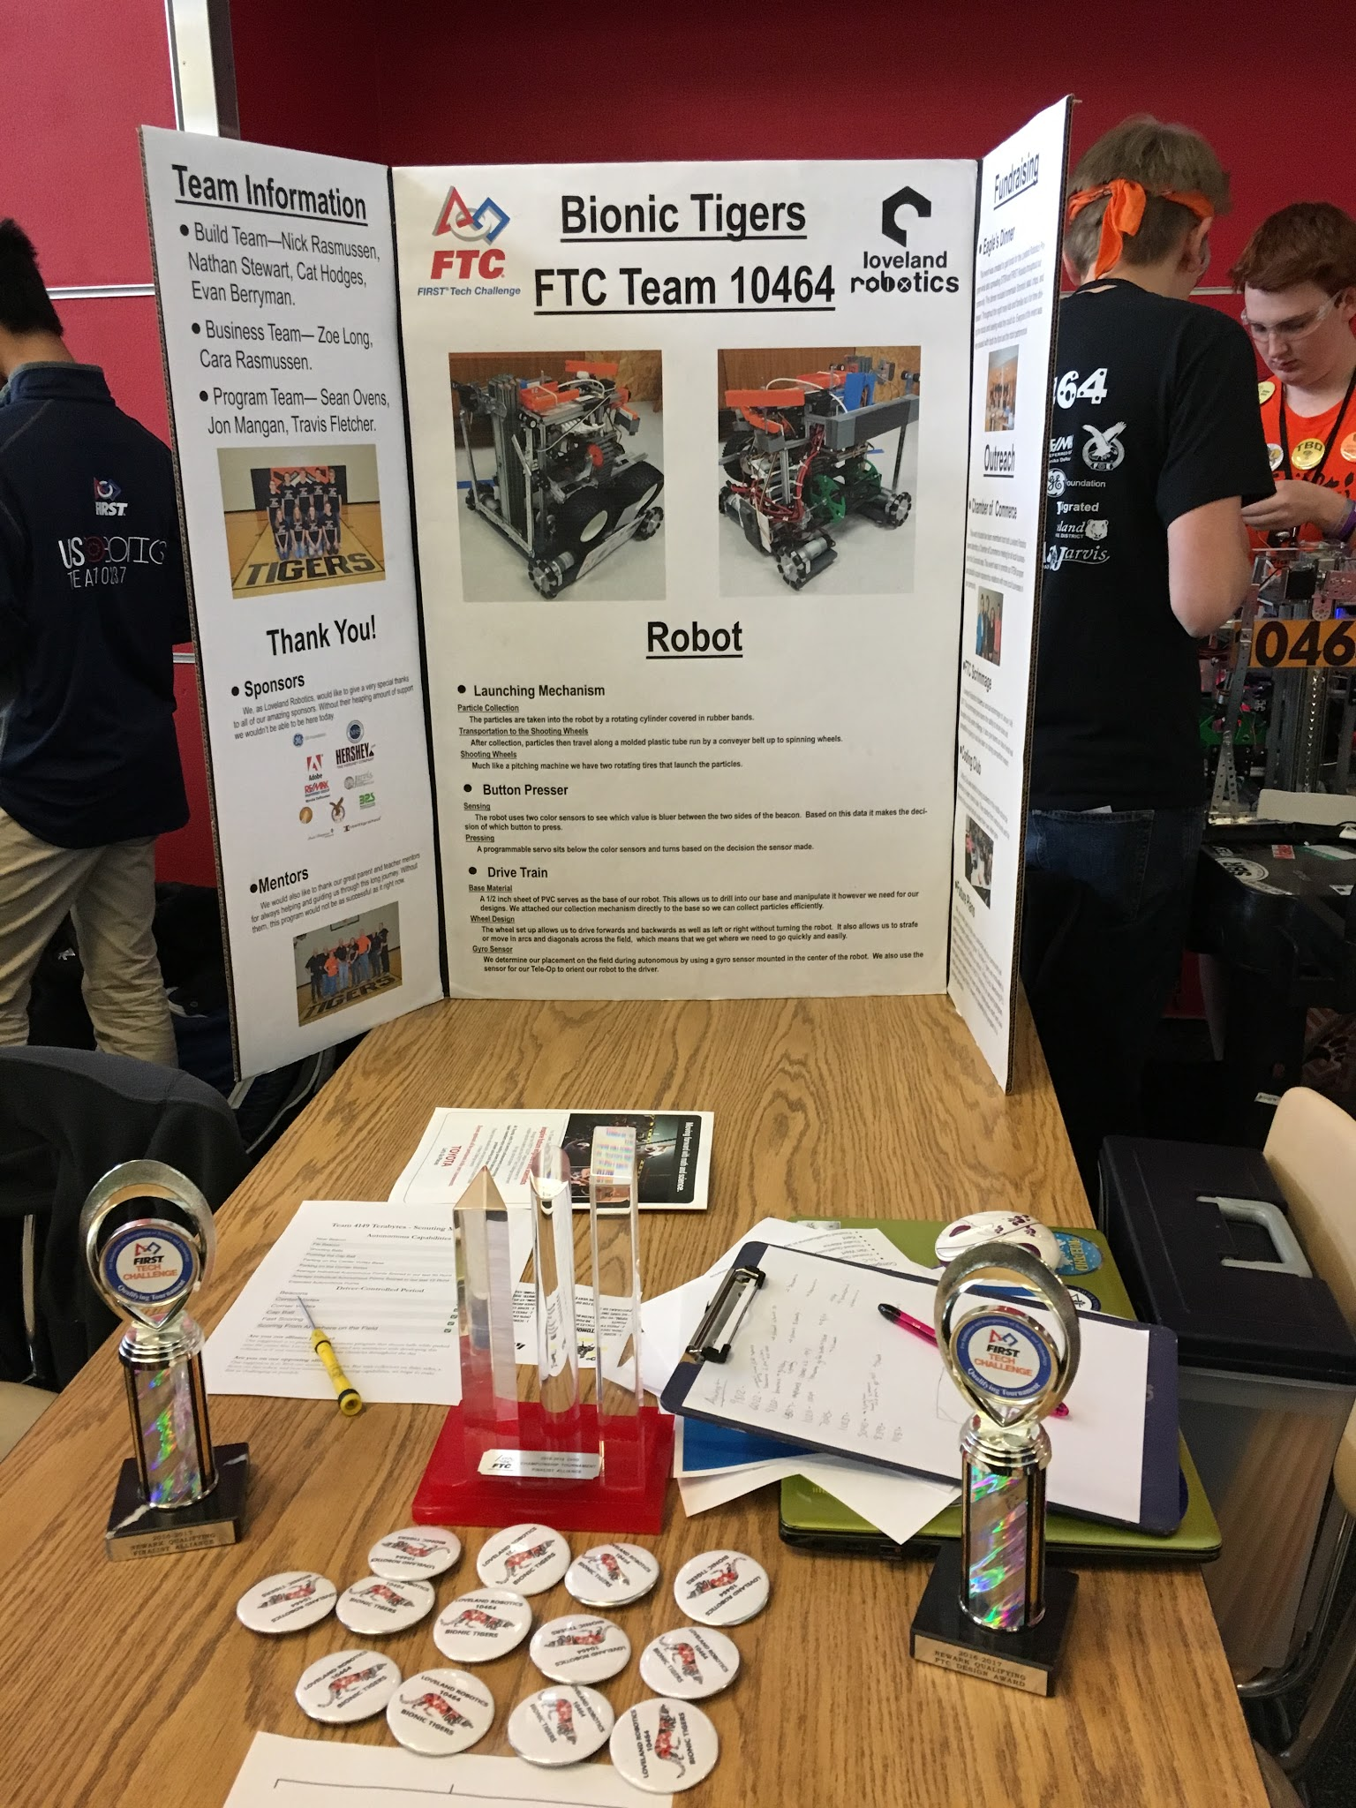
Competitions
Practice
Presentation
Autonomous
Driver
Have Robot prepared
Print Engineering Notebook
Turn in award videos
Handouts
Scouting sheet information
Buttons/Bracelets
Displays
Pit displays
Interview visuals
Spirit items
Make a packing list
Make a schedule and plan out your weeks until competition

Slide 10
Scheduling
Leave a buffer week incase building or programming takes longer than expected
Auto week
allow programmers to have full control of robot to test with all mechanisms done
Prototype week
Build week
Presentation
Drive practice week

Slide 11
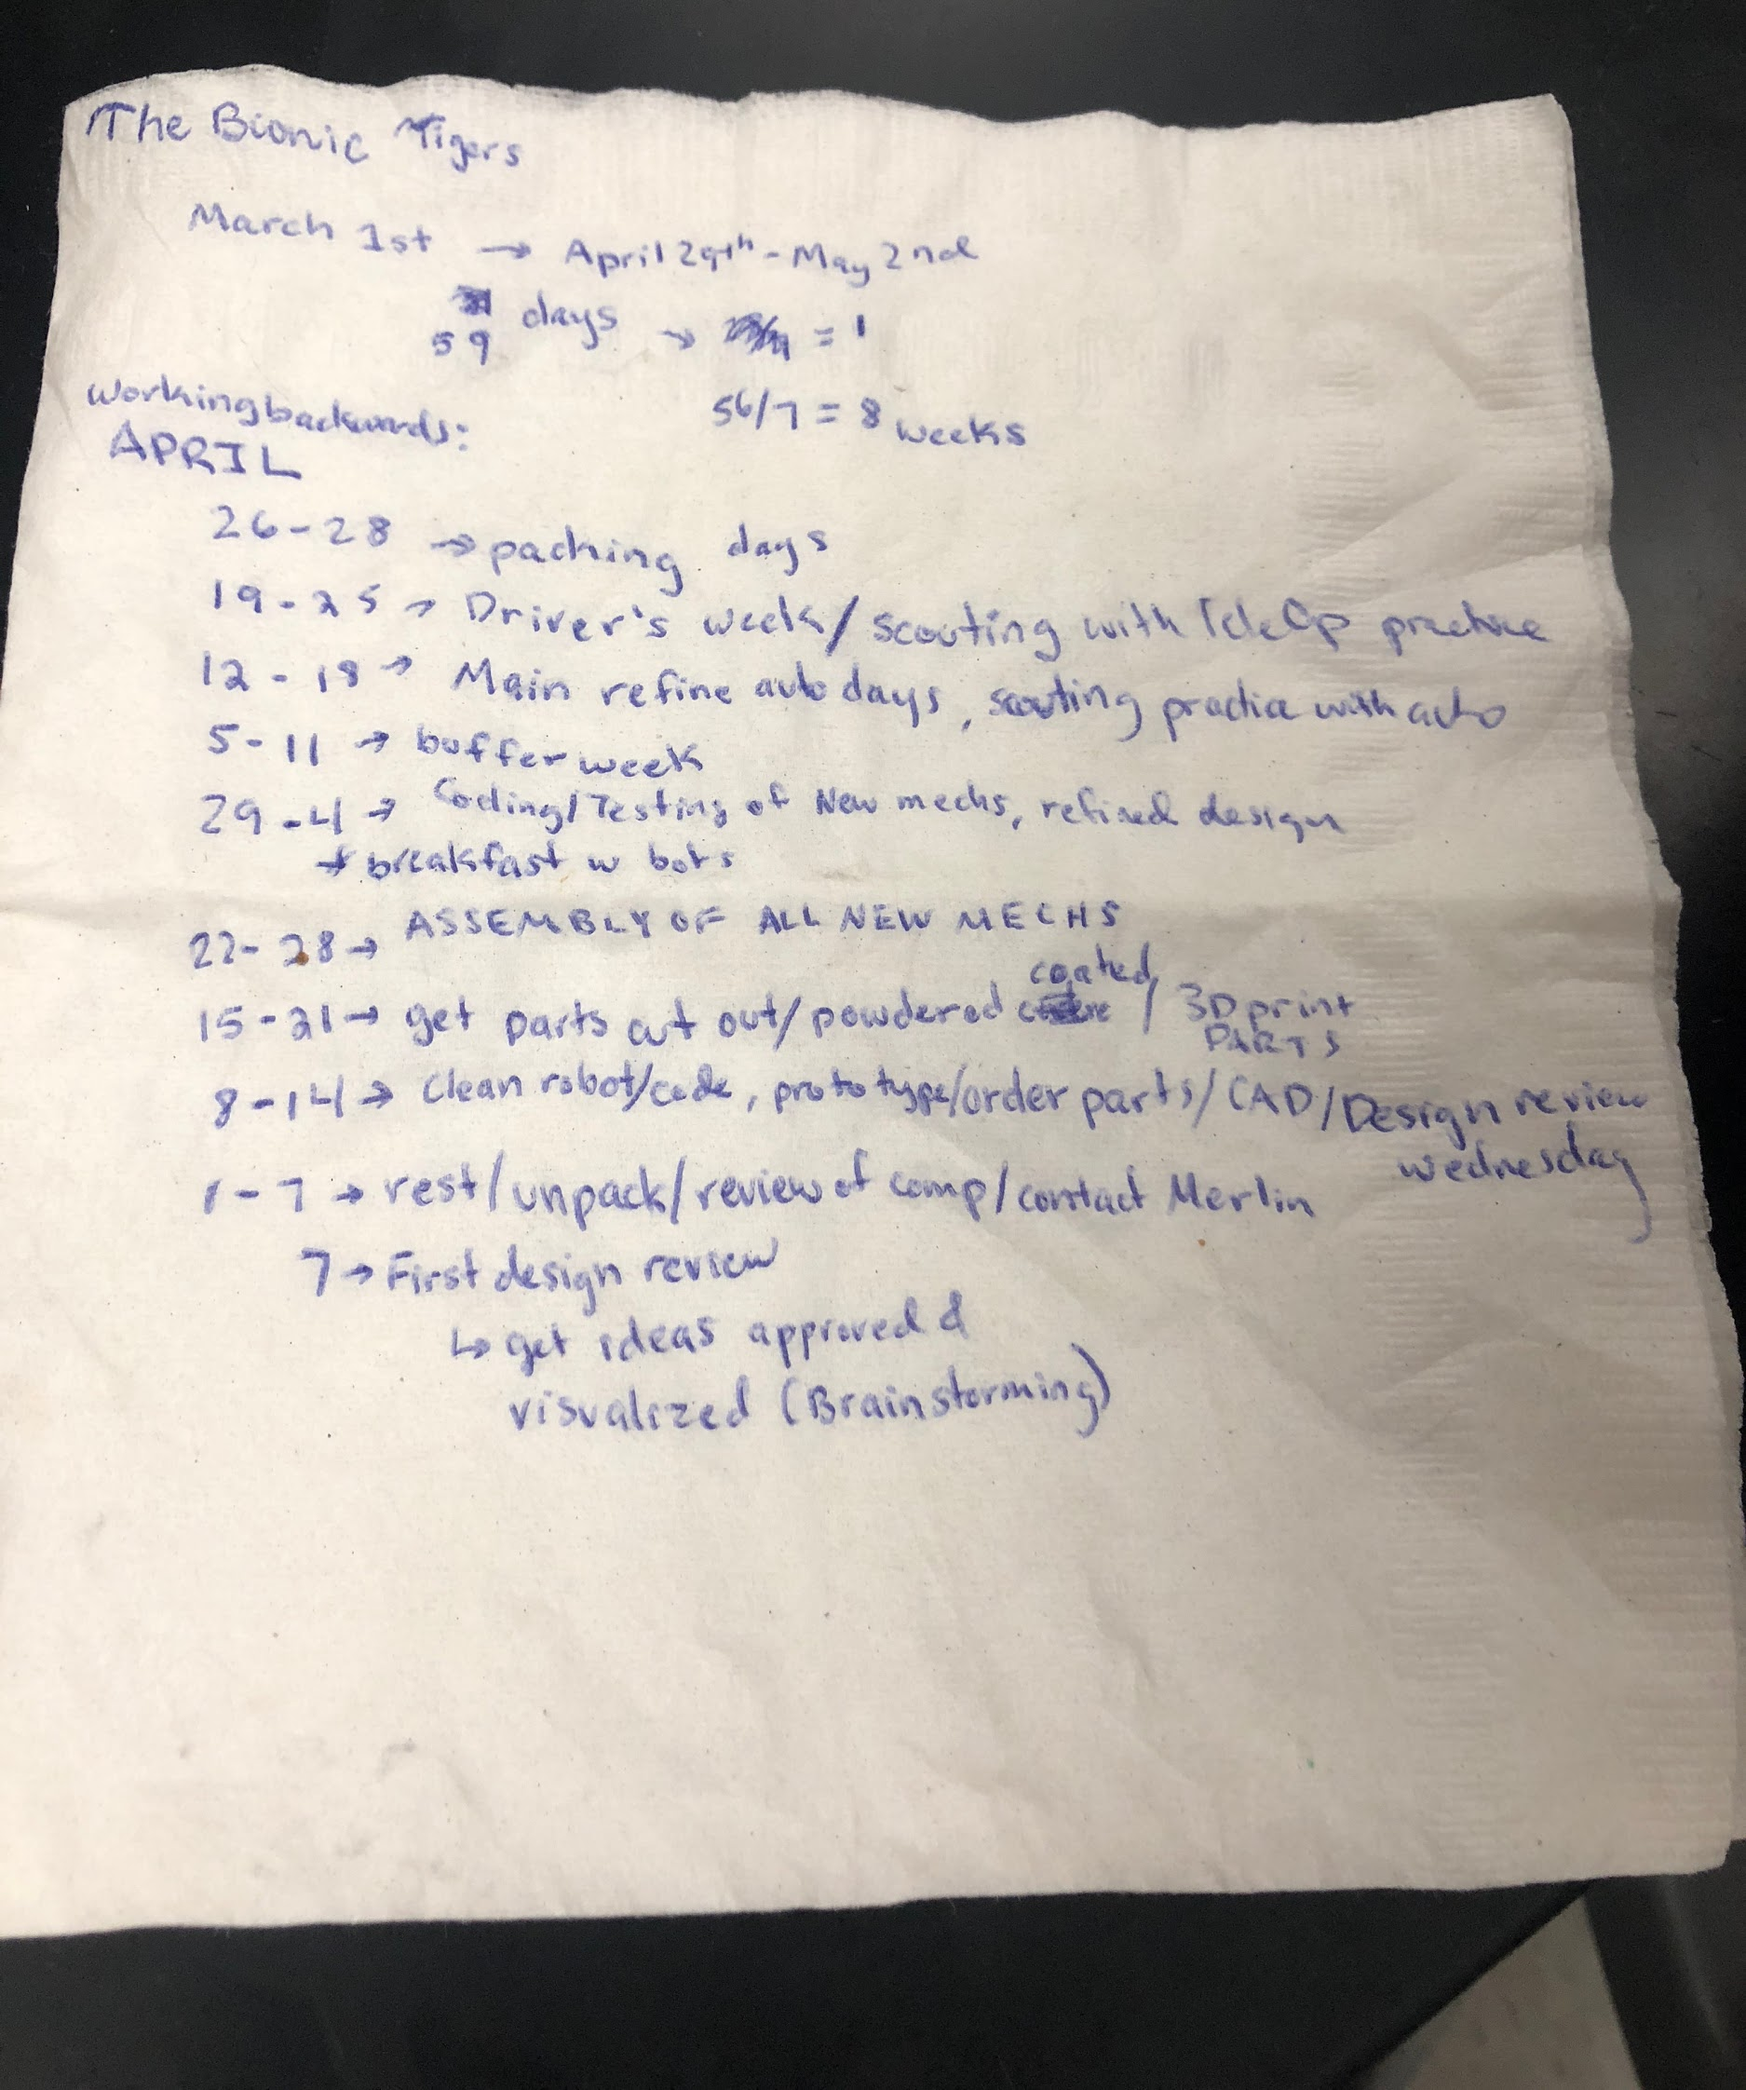
Scheduling Example
Use google sheets, but napkins work too

Slide 12

Credits
This lesson was written by The Bionic Tigers 10464 for FTCTutorials.com
You can contact the author at:
Website:
http://lovelandrobotics.com/team10464
Twitter:
@BionicTigersFTC
Email:
BionicTigers10464@gmail.com
More lessons for FIRST Tech Challenge are available at www.FTCtutorials.com
This work is licensed under a
Creative Commons Attribution-NonCommercial-ShareAlike 4.0 International License.

